Slide 1
Respect, Relationships and Resiliency
Pine-Richland School District
Presented by: Maura L. Paczan, Ph.D.

Slide 2
Stress on Children and Adolescents
There will always be stress in our lives.
Our body’s reaction to stress is mediated through complex sensory input-sights/ sounds, brain nervous system, hormones, body’s cells and organs.
Emotions play an important role in how we experience stress- the brain is the conductor of this system.
Healthychildren.org
Stress on Children and Adolescent

Slide 3
Stress on Children and Adolescents
Good Stress:
The optimal amount of stress that leaves us feeling energized and motivated
Encourages us to develop effective coping strategies to deal with our challenges
This ultimately contributes to resilience.
Bad Stress
Results when coping mechanisms are overwhelmed by the stress, and we are unable to function at our best.
This affects children and adults in various ways
The solution to bad stress is to adapt, change, and find
methods that helps to turn that bad stress into good
stress.
Stress on Children and Adolescent

Slide 4
Causes of Stress for Children and Adolescents
At Home
A lack of family routines
Over-scheduling
Prolonged or serious illness
Poor nutrition
Change in the family situation
Financial problems
Family strife or abuse
Unclear or unreasonable expectations

Slide 5
Causes of Stress for Children and Adolescents
At School
Unstructured classroom
Unclear or unreasonable expectations
Fear of failure
Peer-related
Changing school buildings
Dealing with a bully
Fitting in with the crowd
Moving to a new community

Slide 6
Symptoms of Stress in Children and Adolescents
Irritability or unusual emotionality or volatility
Sleep difficulty or nightmares
Change in appetite
Decrease in school attendance and avoidance behaviors
Inability to concentrate
Drop in grades or other functioning
Toileting concerns
Headaches or stomachache
Unexplained fears or increased anxiety (that also can take the form of clinging)
Regression to earlier developmental levels
Isolation from family activities or peer relationships
Drug or alcohol experimentation

Slide 7
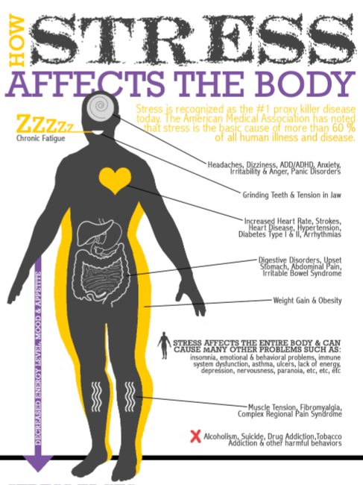

Slide 8
Strategic Initiative: Resiliency
Resiliency is the ability to adapt well in the face of hard times and build upon one’s strengths.
Adapted from the American Psychological Association (APA), 2011.
From the Pine-Richland School District Strategic Plan, the District’s Pupil Services’ goal is to empower students to be successful in achieving their goals, pursuing their interests, and managing their lifelong learning.

Slide 9
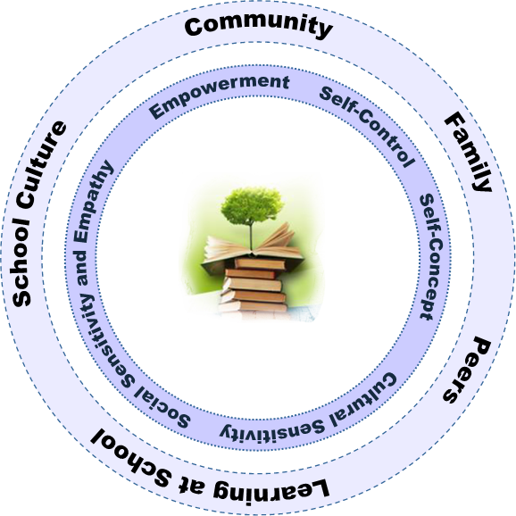
Resiliency Framework Internal and External Strengths
Adopted from Resiliency Initiatives (2003)

Slide 10
External Strength: Community
Neighborhood Boundaries: Strong parental commitment to neighborhood, school attendance areas, and neighborhood organizations
Adult Relationships: Viable church groups, community sport leagues, and community centers
Community Values Youth: Parks, recreation, sports, nature, healthy life styles, medical services, churches, community centers, the Alliance for Safe and Drug Free Children, and mental health agencies
Caring Neighborhoods: Supportive neighborhoods and neighborhood identities

Slide 11
External Strength: Family
Caring Families: Supportive families, strong attendance at school events, parents initiate contact with school staff
Family Communication: Electronic, hard copy , and face-to-face communication with school
Adult Family Members as Role Models: Students follow parents’ footsteps; parents serve as coaches, group leaders, volunteers, and members of PTOs and School Board

Slide 12
External Strength: Family
Family Support: Awareness of the academic, social and emotional needs of their children and initiation of communication with schools when issues arise
Parental Role in Education: Advocacy for their children and support for the education of all children through assistance in school services and programs, fundraising, strategic planning, booster organizations, and volunteering
High Expectations: For student learning, student behavior, and excellent schools

Slide 13
External Strength: Peers
Positive Peer Relationships: Bucket Fillers (K-3) program, Peer to Peer group, Best Buddies club, Ram Ambassadors group, Student Leadership group, conflict resolution groups, bullying prevention and positive peer relationship programs
Positive Peer Influence: Groups and clubs mentioned above and opportunities for older students to travel to other schools to interact with younger students

Slide 14
External Strength: Learning at School
School Work: Online resources, assignment notebooks, school counselors teaching study skills, after school tutoring, peer tutoring, outside tutoring agencies, ongoing communication and meetings with parents
School Engagement: Athletics, extracurricular activities, ROTC, transition activities, positive school climate, positive relationships with teachers and adults in the schools
Achievement: Secondary school Student Assistance Programs, RtII, peer tutoring, outside tutors and learning centers

Slide 15
External Strength: Learning at School Actions Taken
School-based mental health services at the high school.
Strengthen the Student Assistant Programs at Eden Hall, Middle and High Schools.
Response to Instruction and Intervention (RTII) K-8
Pupil Service Meetings (K-12)
Staff members at the HS spoke to students about being Responsible Reporters.
Olweus Bullying Prevention kick-off of Being Respectful to Others
Act 71: Suicide Awareness and Prevention Bill, the district will adopt an age appropriate youth suicide awareness and prevention policy-Must provide 4 hours of training every 5 years in suicide awareness and prevention for professional educators in buildings serving students in grades 6-12.

Slide 16
Role of Student Support Teams at School
RtII
Principals, counselors, all classroom teachers, Reading Support, Intervention Specialists
Response to monitoring of student progress and review of achievement data
Example: AIMSweb scores indicate a student needs Reading Support
SAP
Principals, counselors, some teachers, School Psychologists, Social Worker, Drug and Alcohol Liaison
Response to observed, at-risk behavior; may be a change in behavior
Example: Student with erratic attendance would be helped by having a mentor as school
PST
Principals, counselors, School Psychologists, Social Worker
Response to students with most intense needs; often requires inter-agency coordination
Example: Student is returning to school from a mental health hospital and needs multiple check-ins with school staff
All include parent communication

Slide 17
Schedule of Student Support Teams at School
Student Needs: | RtII | SAP | PST
Academic | x | x
Emotional/Behavioral |  | x | x
Drug and Alcohol |  | x | x
Building Teams: | RtII | SAP | PST
Grade K-3 | x |  | x
Grade 4-6 | x | x | x
Grade 7-8 | x | x | x
Grade 9-12 |  | x | x

Slide 18
External Strength: School Culture
High Expectations of School: To help students define their passions and develop internal motivation
Bonding to School: Active, connected, engaged students
Caring School Climate: Positive relationships between teachers and students
School Boundaries: Students as district ambassadors demonstrating school pride through their behaviors outside of school

Slide 19
Students Reporting Empathy for Those Being Bullied

Slide 20
Students Reporting They Have More Than One Good Friend

Slide 21
Students Reporting They Like School

Slide 22
10 Tips for teaching children and adolescents Resiliency
1. Make connections
Teach your child how to make friends, including the skill of empathy, or feeling another's pain.
Encourage your child to be a friend in order to get friends.
Build a strong family network to support your child through his or her inevitable disappointments and hurts.
Connecting with people provides social support and strengthens resilience.
2. Help your child by having him or her help others
Children who may feel helpless can be empowered by helping others.
Engage your child in age-appropriate volunteer work, or ask for assistance yourself with some task that he or she can master.
3. Maintain a daily routine
Sticking to a routine can be comforting to children, especially younger children who crave structure in their lives.
Encourage your child to develop his or her own routines.

Slide 23
10 Tips for teaching children and adolescents Resiliency
4. Take a break
Teach your child how to focus on something besides what's worrying him.
Be aware of what your child is exposed to that can be troubling, whether it be news, the Internet or overheard conversations, and make sure your child takes a break from those things if they trouble her.
5. Teach your child self-care
Make yourself a good example, and teach your child the importance of making time to eat properly, exercise and rest.
Make sure your child has time to have fun, and make sure that your child hasn't scheduled every moment of his or her life with no "down time" to relax.
Caring for oneself and even having fun will help your child stay balanced and better deal with stressful times.
6. Move toward your goals
Teach your child to set reasonable goals and then to move toward them one step at a time.
Moving toward that goal — even if it's a tiny step — and receiving praise for doing so will focus your child on what he or she has accomplished rather than on what hasn't been accomplished, and can help build the resilience to move forward in the face of challenges.

Slide 24
10 Tips for teaching children and adolescents Resiliency
7. Nurture a positive self-view
Help your child remember ways that he or she has successfully handled hardships in the past and then help him understand that these past challenges help him build the strength to handle future challenges.
Help your child learn to trust her/himself to solve problems and make appropriate decisions.
Teach your child to see the humor in life, and the ability to laugh at one's self.
8. Keep things in perspective and maintain a hopeful outlook
Even when your child is facing very painful events, help him look at the situation in a broader context and keep a long-term perspective.
Although your child may be too young to consider a long-term look on his own, help him or her see that there is a future beyond the current situation and that the future can be good.
An optimistic and positive outlook enables your child to see the good
things in life and keep going even in the hardest times.

Slide 25
10 Tips for teaching children and adolescents Resiliency
9. Look for opportunities for self-discovery
Tough times are often the times when children learn the most about themselves.
Help your child take a look at how whatever he is facing can teach him "what he is made of.”
10. Accept that change is part of living
Change often can be scary for children and teens.
Help your child see that change is part of life and new goals can replace goals that have become unattainable.

Slide 26
Build Grit and Perseverance
https://www.ted.com/talks/angela_lee_duckworth_the_key_to_success_grit?language=en.

Slide 27
Final Thoughts
Persistence and resilience only come from having been given the chance to work through difficult problems.
~ Gever Tulley
At Pine-Richland, we must do all we can to help those working through difficult problems.

Slide 28
Resiliency: Resources
American Psychological Association (2011). Resilience Guide for Parents and Teachers. http://www.apa.org/helpcenter/road-resilience.aspx
American Psychological Association (2011). Resilience for Teens. http://www.apa.org/helpcenter/bounce.aspx.
American Psychological Association (2011). Road to Resilience. http://www.apa.org/helpcenter/road-resilience.aspx
Dweck, C. (2006). Mindset. New York: Ballantine Books.
Galinsky, E. (2010). Mind in the making: The seven essentials life skills every child needs. Harper Collins.
Harvey, V. S. (2004). Resiliency: Strategies for Parents and Educators. National Association of School Psychologists, www.nasponline.org. Henderson, N. (2013). Havens of Resilience. Educational Leadership. 23-27.
Perkins-Gough, D. (2013). The Significance of Grit, A Conversation with Angela Lee Duckworth. Educational Leadership. 15-20.
Resiliency Initiatives (2003). Understanding the Resiliency Framework. http://resiliencyinitiatives.com.

